Slide 1
COVID19 Analysis (India)
By: Nandini Verma

Slide 2
Introduction
The project focuses on analyzing the impact of the pandemic within the context of India.
My research delves into several critical areas, including the spread of the virus, the effectiveness of the vaccinations and growing mortality rate (state wise).
Through data extraction and rigorous analysis, I have sought to answer vital questions such as: How has the virus spread across different regions of India? How does the mortality rate differs state wise? Analysis of the vaccinated population.
It offers valuable insights into the effectiveness of past strategies and identifies potential areas of improvement.

Slide 3
Data Preprocessing
Receive data in json file
Data extraction
Converted data into a dataframe
Started cleaning the data- removed null values, noise, replaced null values with zero.
Identified and rectified errors, inconsistencies, and inaccuracies in the data.

Slide 4
Analytical Findings
Weekly evolution of number of confirmed cases, recovered cases, deaths, tests.

Slide 5
2. Testing ratio(tr) = (number of tests done) / (population), now categorise every district in one of the following categories:
Category A: 0.05 ≤ tr ≤ 0.1
Category B: 0.1 < tr ≤ 0.3
Category C: 0.3 < tr ≤ 0.5
Category D: 0.5 < tr ≤ 0.75
Category E: 0.75 < tr ≤ 1.0

Slide 6
3. Generate 2 - 3 insights
Insight 1:Death Rate by State and Population
Insight 2: Recovery Rates by state

Slide 7
4. Compared delta7 vaccinated state

Slide 8
5. KPI 1: Case Severity Ratio
KPI 2: Death Rate per Million

Slide 9
6. Categorized total number of confirmed cases in a state by Months

Slide 10
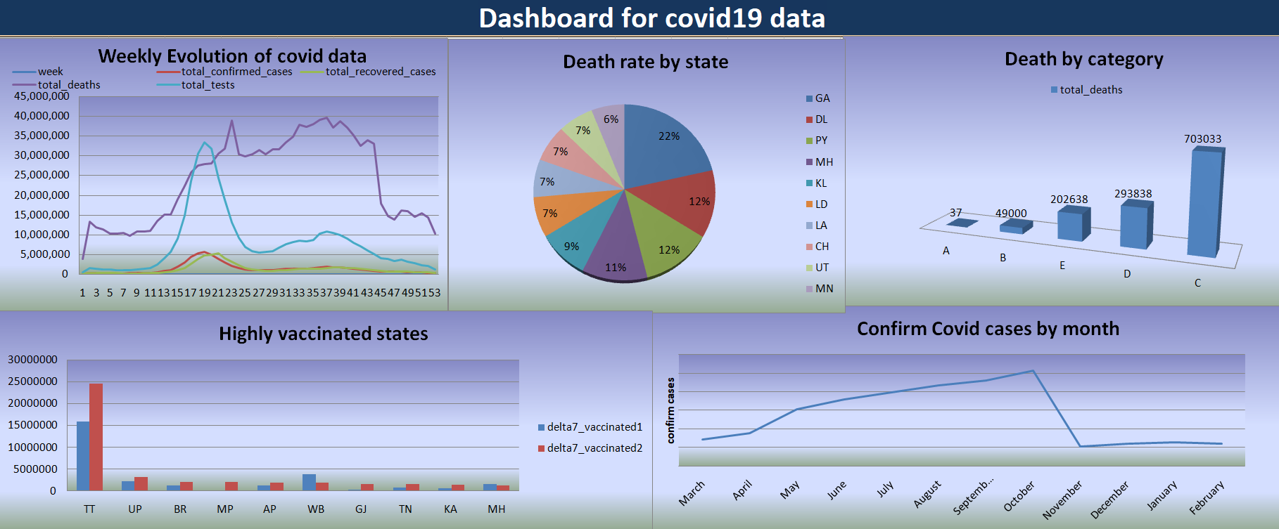

Slide 11
Business Impact
The vaccination drive played a crucial role in the economic recovery of the country. As more people got vaccinated, consumer confidence increased, leading to a gradual revival of various industries.
Offering vaccination support to employees enhanced workforce retention. Businesses that provided vaccination facilities or assisted in vaccination appointments demonstrated a commitment to employee well-being and safety.

Slide 12
Conclusion
The project has contributed to a comprehensive understanding of the COVID-19 situation in India.
The analysis highlighted significant regional variations in COVID-19 cases, emphasizing the need for targeted strategies to address hotspots and areas with higher vulnerability.
The project highlighted the disproportionate impact of COVID-19 on vulnerable populations, emphasizing the importance of targeted measures to protect and support these groups.
The project's findings suggest avenues for further research and analysis. Area like long-term economic implications can be explored to deepen our understanding of the evolving COVID-19 landscape in India.

